Slide 1
AI for Kids
UK Robotics Week 2024

Slide 2
This Story is about it's about superhero who wants to use generative AI effectively and ethically
This story is created by:
John
Mary
Manal

Slide 3
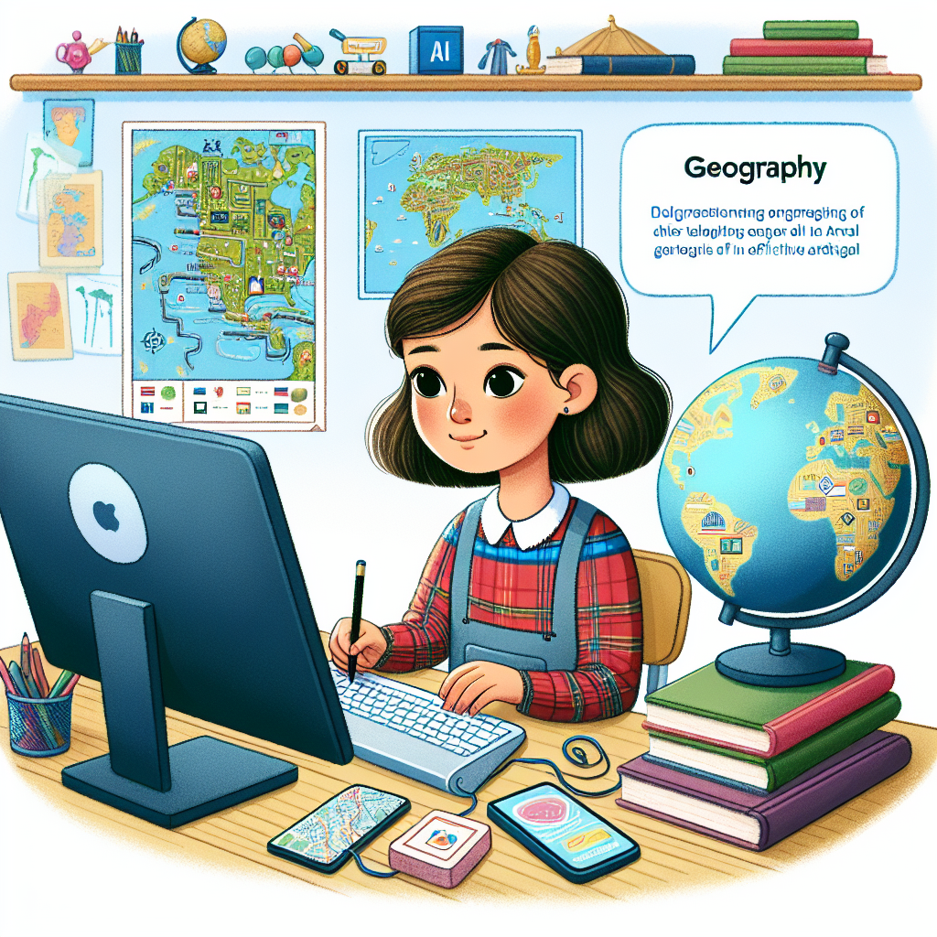
That sounds like a heroic start to the day! Superheroes using AI to plan healthy habits and to excel in their studies is impressive. It's inspiring to see the superhero finding innovative ways to balance academics and family time effectively. It's great to see the superhero interested in history and using generative AI to enhance learning and leisure activities. The superhero seems to be leveraging AI in their daily routines seamlessly - from breakfast planning to engaging with teachers and colleagues. Studying ancient civilizations with generative AI is a unique way to learn history. It's impressive to see the superhero progressing academically and exploring different historical eras with
AI support. Transitioning to university and continuing the journey of learning with AI is commendable. The superhero's interest in history and comparative studies is intriguing, leveraging generative AI for a deeper understanding. Graduating and proposing a historical research topic is a significant accomplishment for the superhero. It's wonderful to see the superhero's academic journey evolve, culminating in a focus on archaeology and monuments for their PhD studies. It's a fantastic feat to see the superhero completing this chapter of their educational quest. It's exciting to see a young student eager to explore geography with the help of generative AI, emphasizing the importance of using technology ethically and effectively.
Illustration for a children's story book. The picture represents a female primary school student of Hispanic descent, showing a keen interest in geography. She's sitting at her study desk, surrounded by maps, globes and geography textbooks. Simultaneously, she's also using her computer, demonstrating the use of generative AI in an effective and ethical manner. The artwork captures her curiosity and enthusiasm for both her subjects, geography and AI.

Slide 4
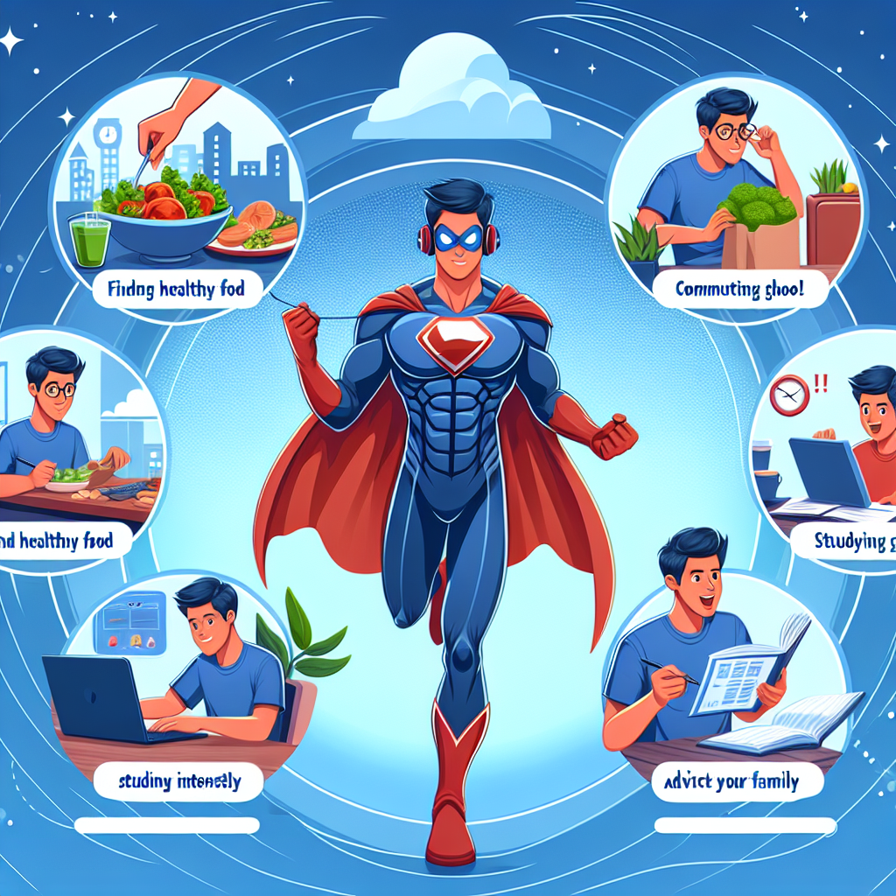
In a distant future, a superhero starts the day by using generative AI for planning a healthy breakfast and navigating school interactions. This superhero is curious about history and becomes a key player in reinforcement learning algorithms. The hero's journey continues as they advance to university, diving deeper into
ancient civilizations using AI. As graduation approaches, the superhero delves into proposing a PhD topic on archaeology and monuments with AI's assistance. Meanwhile, a young girl in primary school embraces generative AI to learn geography ethically. The superhero effortlessly balances academics, social interactions, and family advice, all thanks to AI.
Create an image of a superhero in action. The superhero is using generative AI to accomplish a variety of tasks. These tasks include finding healthy food, commuting to school, studying intensely, partaking in lively discussions with friends and classmates, and even advising his family on how to make the most out of their leisure time. The character displays a diverse skill set, all aimed at promoting a balanced and healthy lifestyle for themselves and their loved ones.

Slide 5
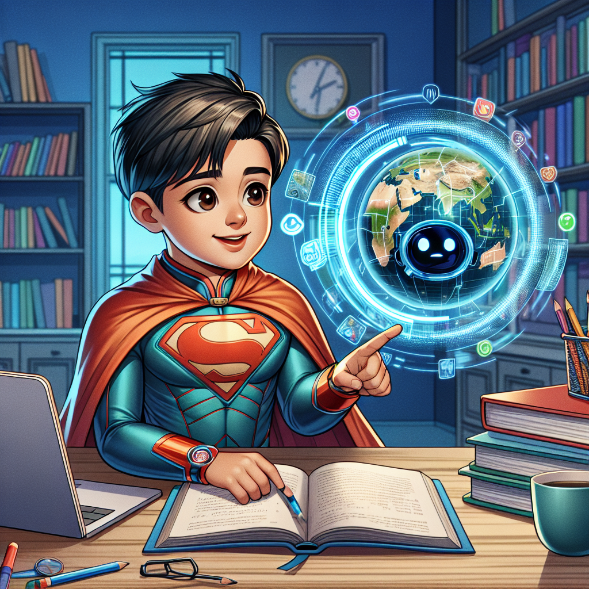
Yes, the superhero in the story is a primary school student who uses generative AI to enhance her learning in geography. She utilizes AI to find healthy food options, plan her journey to school, study effectively, interact with classmates,
and even provide suggestions to her family for leisure activities. Through the assistance of generative AI, she is able to deepen her understanding of geographical concepts, answer questions more efficiently, and complete her assignments with enhanced accuracy and creativity.
Illustrate an image of a young superhero intrigued by geography. This male South Asian character should be in a traditional school setting with textbooks and a geographic globe on the desk. Incorporate a futuristic element within the scene showing him interacting with a generative AI, which is embodied as a smart, holographic display. The AI is assisting him in learning geography, answering complex questions, and aiding in completing his homework. The environment should be vibrant and encouraging to reflect the fun aspect of learning. Captivate the wonder in his eyes as he discovers new places via AI.

Slide 6
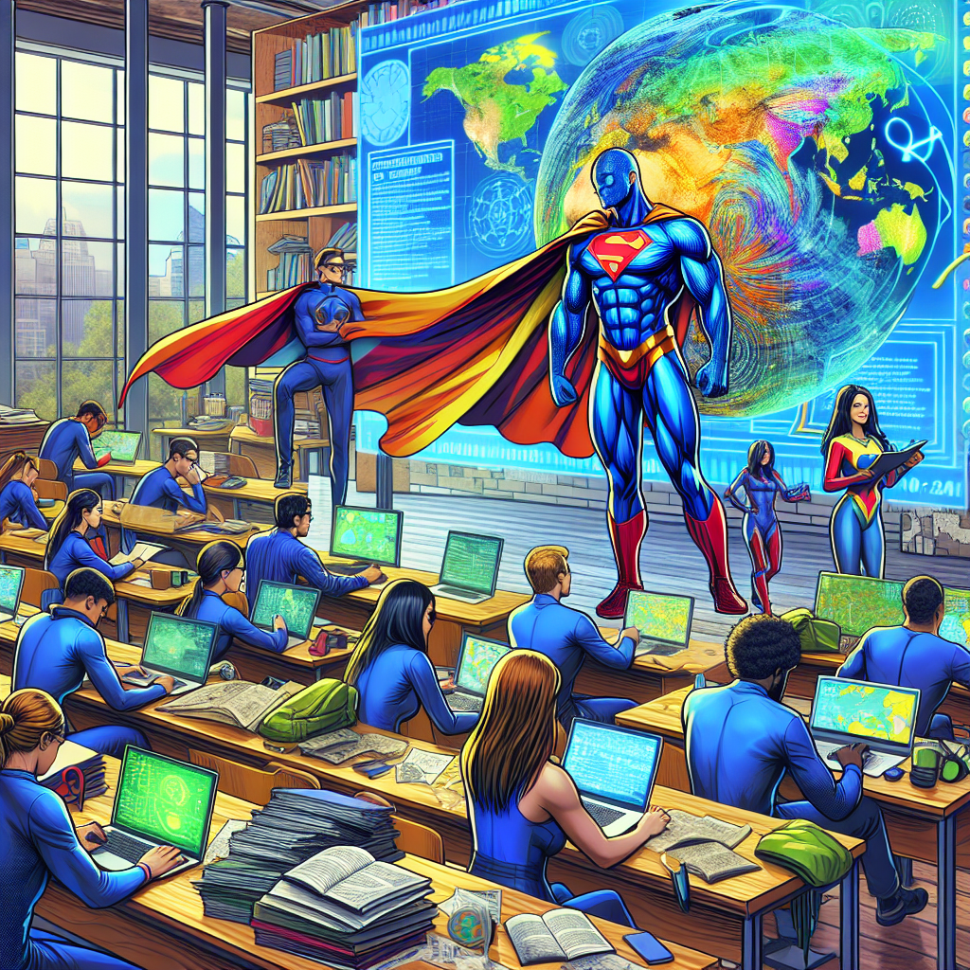
In a world where superheroes use generative AI for everyday tasks, the superhero in our story also utilizes this advanced technology. From planning healthy meals to excelling in academics, the superhero efficiently navigates school life and engages with others. As the superhero
progresses to university, the focus shifts to in-depth studies, like delving into history or geography with generative AI's help. Always striving to learn and grow, the superhero embodies the fusion of human potential and AI capabilities, creating a bright future with endless possibilities.
A vivid scene of a group of superheroes in a university setting, they are engaged in their geography class. These superheroes come from diverse backgrounds, for example, one of them is a Black female, another is a Hispanic male, and the third is a Caucasian non-binary individual. They're immersed in their studies, learning intricate details about the planet. Some are pouring over large, detailed maps while others are conducting deep research on their laptops. They are all working diligently on their graduation projects. In the corner of the room, a generative AI assistant is displaying relevant geographical data on a digital screen. The AI helper is designed to aid the superheroes in their research projects, making their task relatively easier and more efficient.

Slide 7
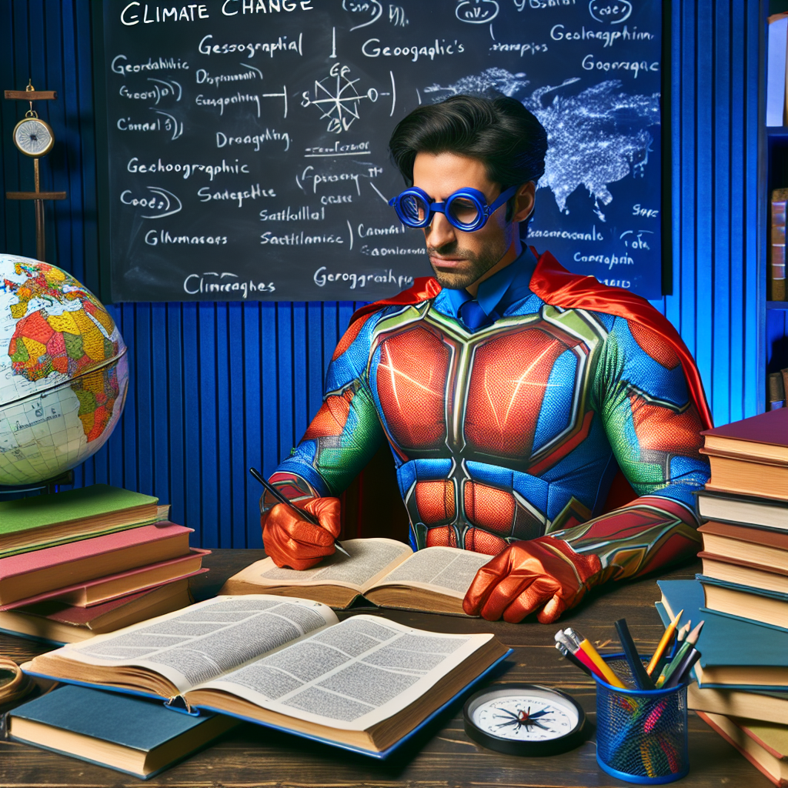
In the early morning, the superhero starts the day with generative AI and plans a healthy breakfast before heading to school to engage with teachers and classmates. Using AI, the superhero efficiently learns history, becomes human-in-the-loop in reinforcement learning, and studies ancient civilizations. As the superhero progresses to university, they
delve deeper into historical studies, including comparative analyses and proposing a historical question for a PhD topic. Meanwhile, a primary school girl superhero explores geography using generative AI ethically and effectively to enhance learning and answer questions, from school assignments to graduation projects and even a potential PhD in geography.
A captivating image of a fictional superhero character, dressed in a colorful and iconic costume, sitting at a desk flooded with books and maps, signifying their studying phase during a PhD. The topic of their PhD is geospatial analysis focusing on climate change. The background is filled with geographical tools like the globe, compass, and satellite images. A chalkboard with complex geographical terms written distinguishes the subject as geography. We can observe a sense of deep concentration and curiosity on the superhero's face.

Slide 8
Thank you for your Participation Today
We hope you enjoyed this experience and find it useful

